Slide 1

Tailored Investment Strategies: Balancing Risk and Return for Mr. Patrick and Mr. Peter Jyengar Presented by: Shikha Upadhyay Harshavardhini JS Megha Pankhuri

Slide 2
Background:
Recently, wealth management has seen a significant growth.
People actively search for opportunities to get the maximum returns in limited time.
A Portfolio manager :
Understands investor’s goals and risk tolerance
Keep a close eye on market stock analytics
Suggest a suitable portfolio that meets all expectations of investor.

Slide 3
Introduction:
In finance and risk analytics, understanding investor goals and risk tolerance is key to crafting effective strategies.
Mr. Patrick Jyengar, a conservative investor, and his high-risk counterpart, Mr. Peter Jyengar, aim to double their capital in 5 years, though their risk appetites differ greatly. The challenge is to tailor strategies that match their distinct objectives.

Slide 4
Understanding the Investors:
Mr. Patrick Jyengar: The Conservative Investor
Objective: With $500K to invest, Patrick seeks a low-risk portfolio that will double his capital over 5 years.
Risk Tolerance: Conservative, aiming to minimize risk while achieving steady growth.
Mr. Peter Jyengar: The Aggressive Investor
Objective: Peter has $1M to invest and is willing to embrace high-risk, high-reward investments to maximise his capital in 5 years.
Risk Tolerance: Aggressive, accepting significant volatility for the chance to maximize returns.

Slide 5
Approach:
a) Loading stock prices, financial indices, and key performance metrics.
b) Data Preparation:
Data Loading: We gathered historical Stock and S&P 500 index data from various sectors, creating a large dataset tracking price movements.
Data Cleaning: Missing values, particularly in stock prices and volumes, were filled using forward fill imputation to ensure continuity without bias.
c) Data visualization of daily prices (Open, High, Low, Close) and trading volumes, across industries of Tech, Healthcare, and Finance.

Slide 6
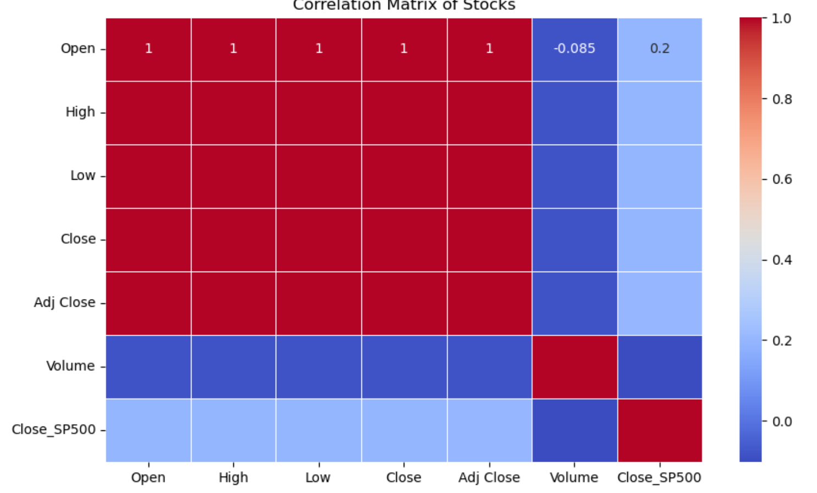
Data Visualization:
Correlation Plot
Insights
Negative Correlation with Volume (-0.085): Stock prices (Open, High, Low, Close, Adj Close) slightly decrease as Volume increases, indicating higher trading activity which may lead to price declines.
Weak Correlation with S&P 500 (0.2): Stock prices show only a minor relationship with the broader market, suggesting individual stocks move independently of the S&P 500.
Stock Performance Drivers: Individual stocks are primarily influenced by sector-specific factors, company performance, and global trends rather than market-wide patterns.

Slide 7
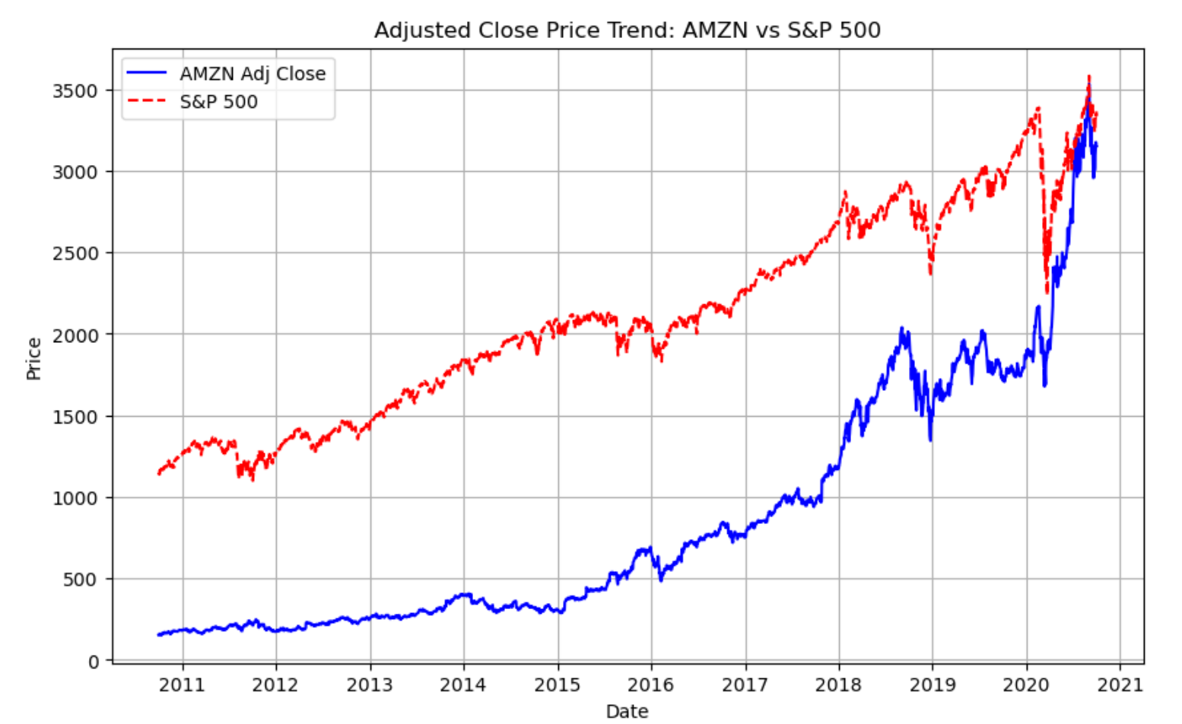
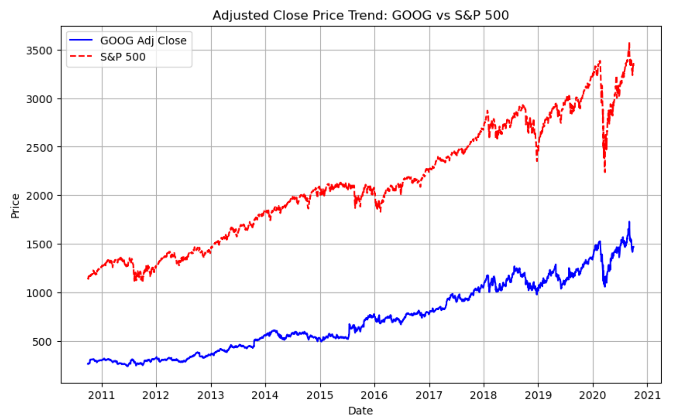
Trend and Sector Analysis:
AMZN and GOOG: Both consistently followed the S&P 500 index but showed steeper price increases, particularly after 2015. This identified them as strong performers suitable for Mr. Peter Jyengar's high-risk strategy.
Sector-Wise Performance: We analyzed stocks from sectors like Finance, Aviation, Healthcare, and Technology to see which offered the best performance for either a conservative or aggressive portfolio.

Slide 8
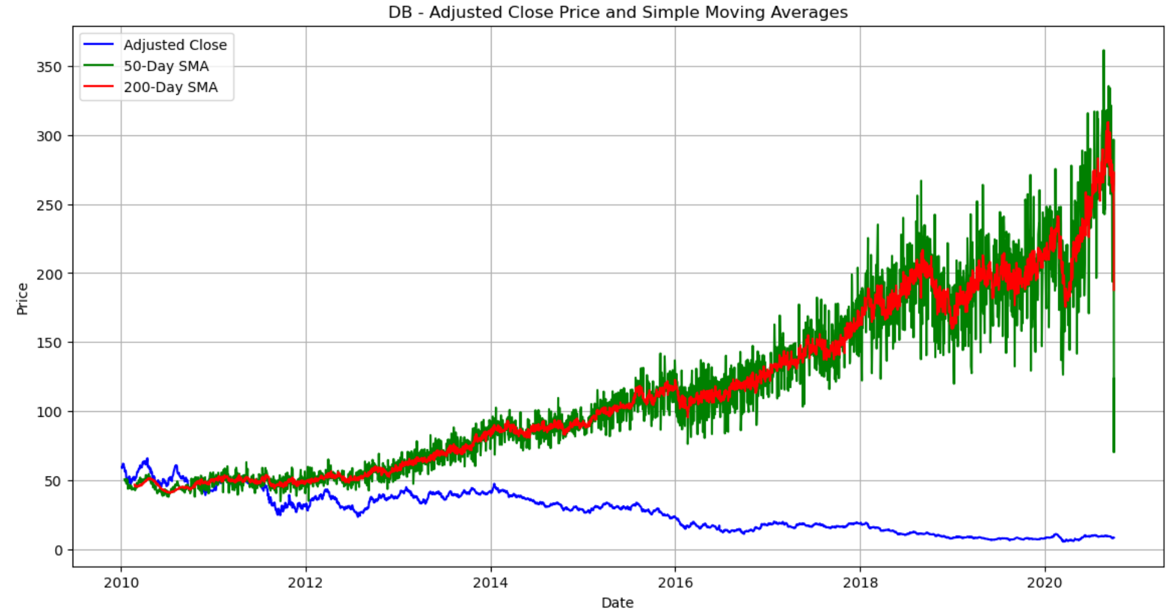
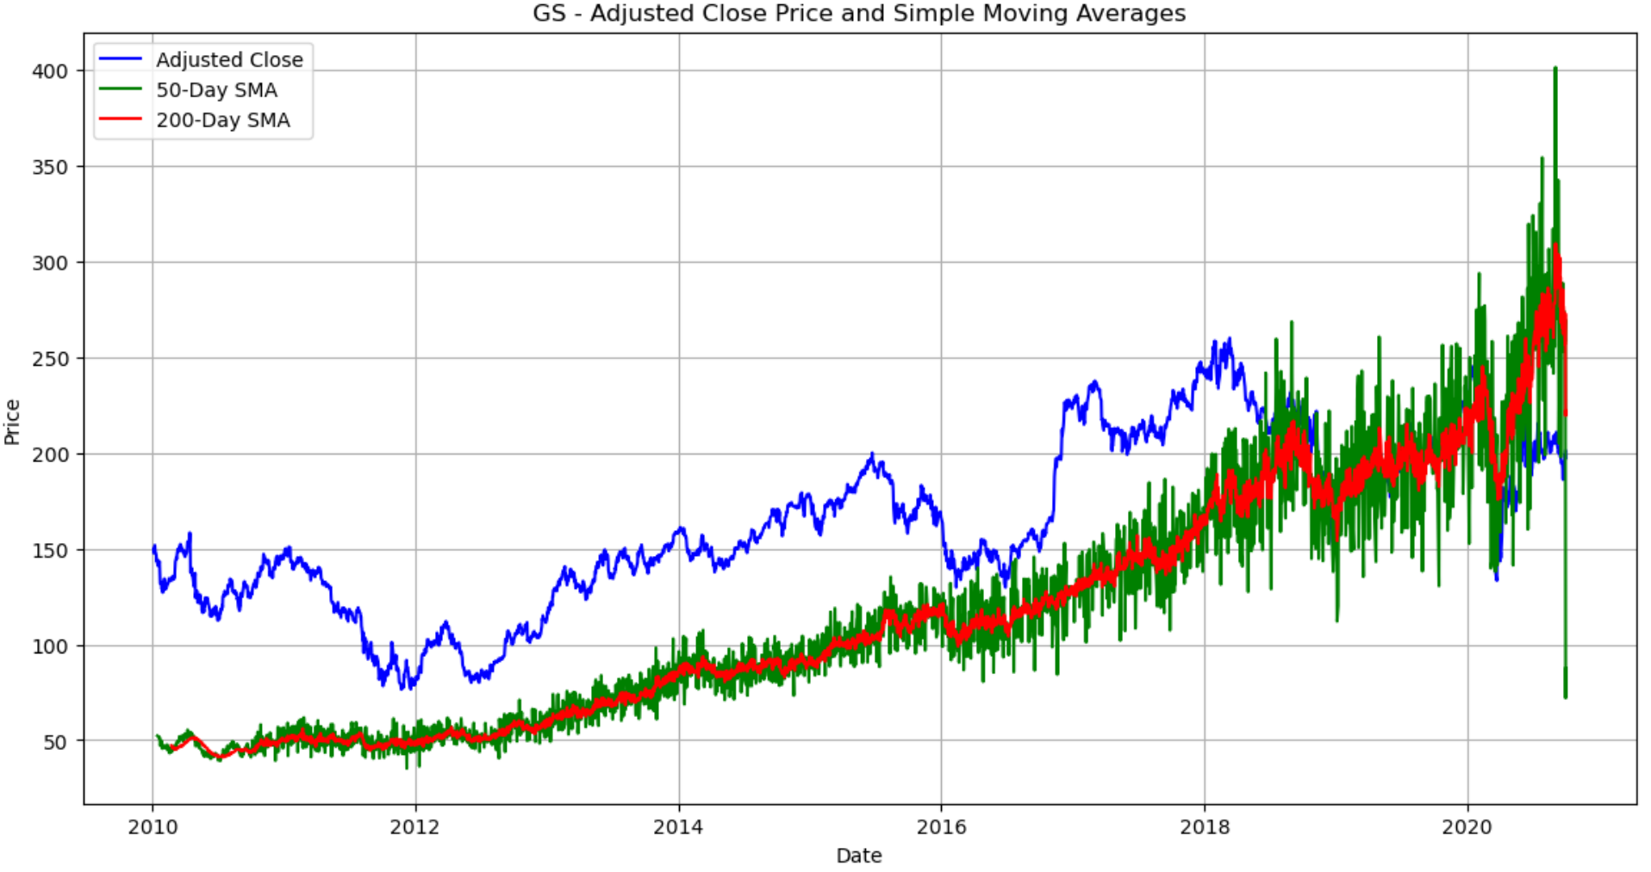
Sector wise Insights from Moving Average Trends:
Finance Sector
Deutsche Bank (DB)
Crossover (2010-2012): Signals trend direction change.
Post-2012: Stock underperformed, declining below moving averages.
Goldman Sachs (GS)
Upward Trend: Stock price increased consistently.
Post-2018: Stock and moving averages aligned, reflecting stability.

Slide 9
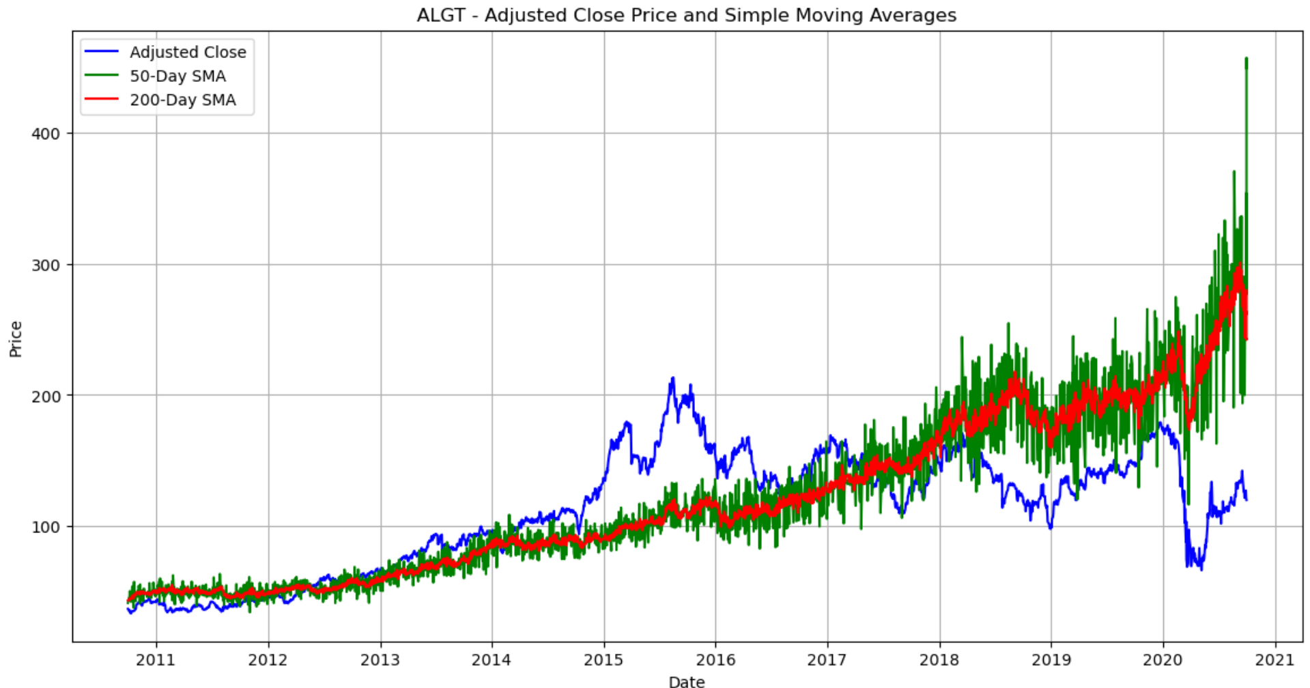
Aviation Sector
Allegiant Travel (ALGT)
Pre-2015: Stable alignment with moving averages.
2014-2016: Outperformed moving averages, indicating growth.
Post-2018: Stock price declined, diverging from moving averages.

Slide 10
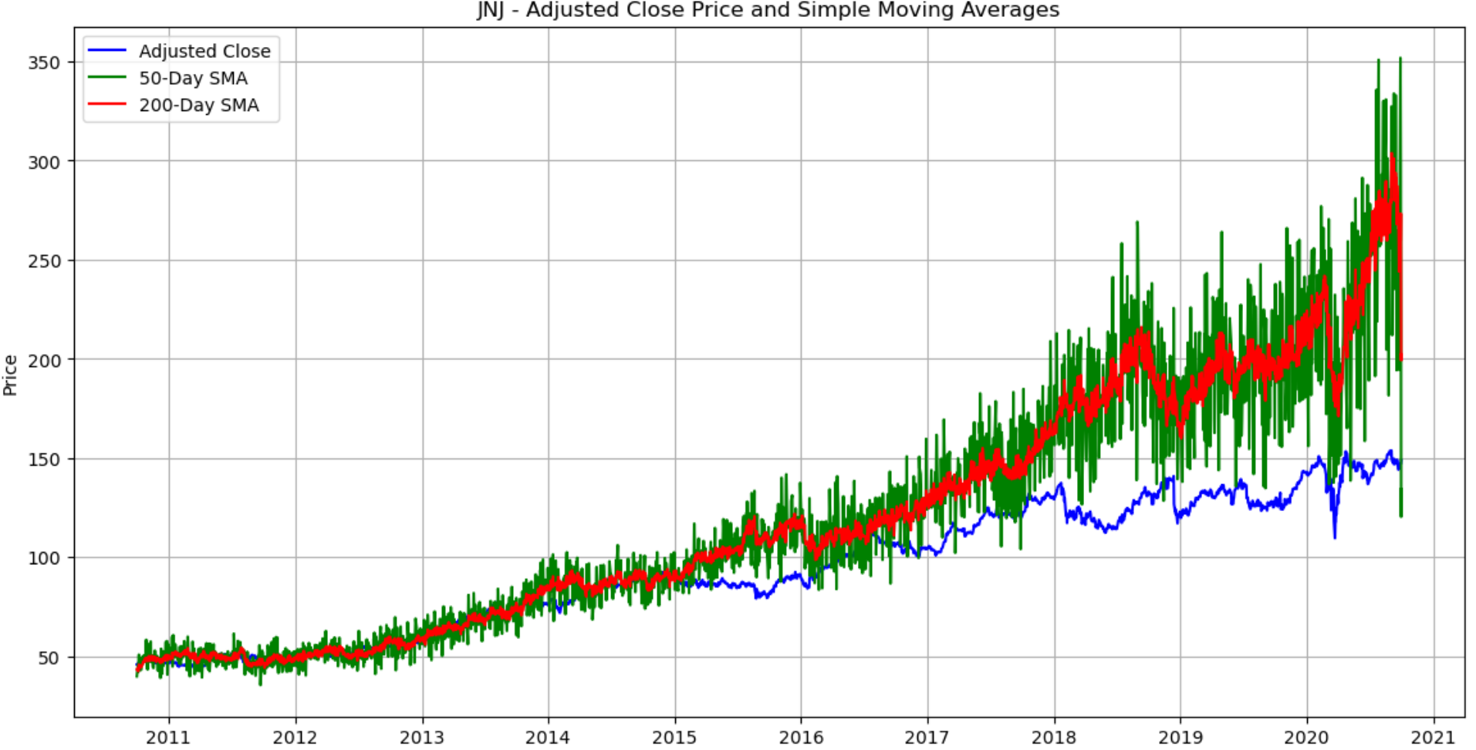
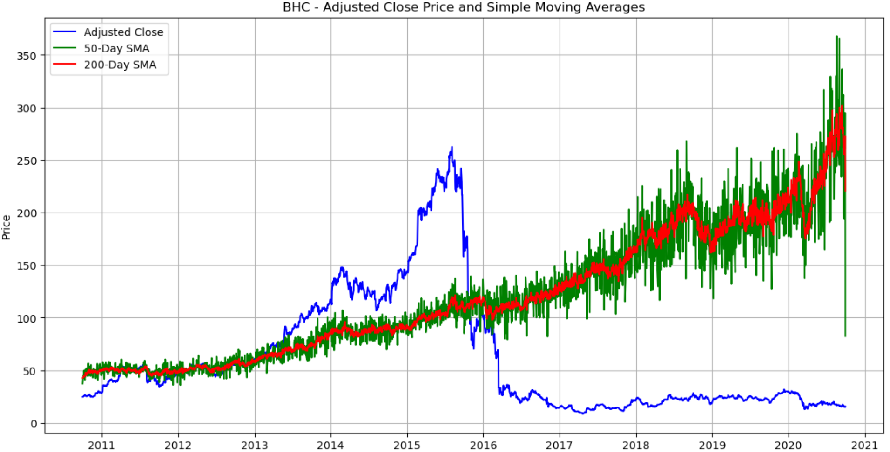
Healthcare Sector:
Johnson & Johnson (JNJ)
Pre-2015: Stock price aligned with moving averages, showing early stability.
Post-2015: Divergence from 2018, indicating volatility or underperformance.
Bausch Health (BHC)
2011-2013: Initial alignment and trend change.
Mid-2013 to 2016: Strong upward trend.
Post-2016: Stock price declined, reflecting underperformance.
UnitedHealth Group (UNH)
Consistent alignment with moving averages, reflecting stable performance.

Slide 11
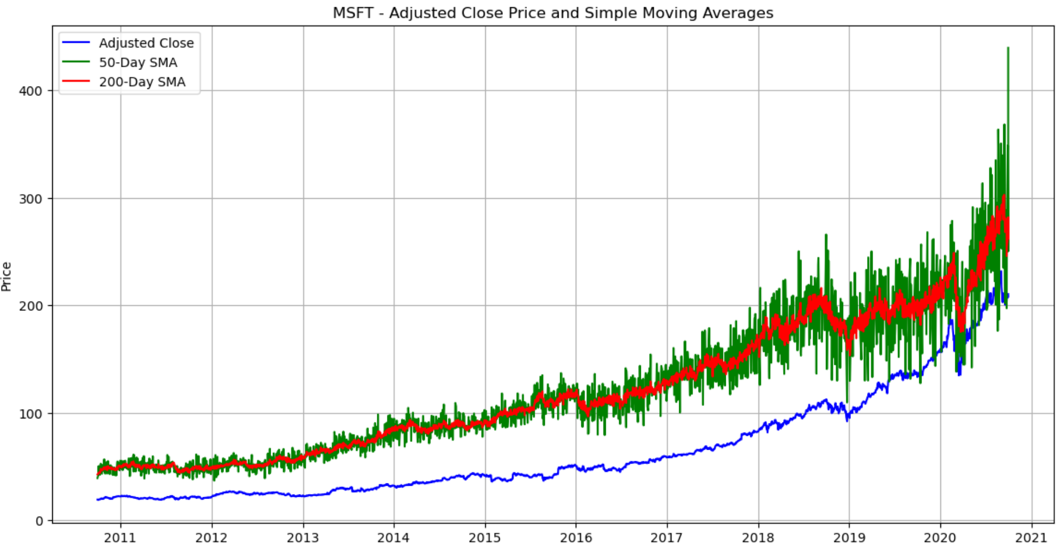
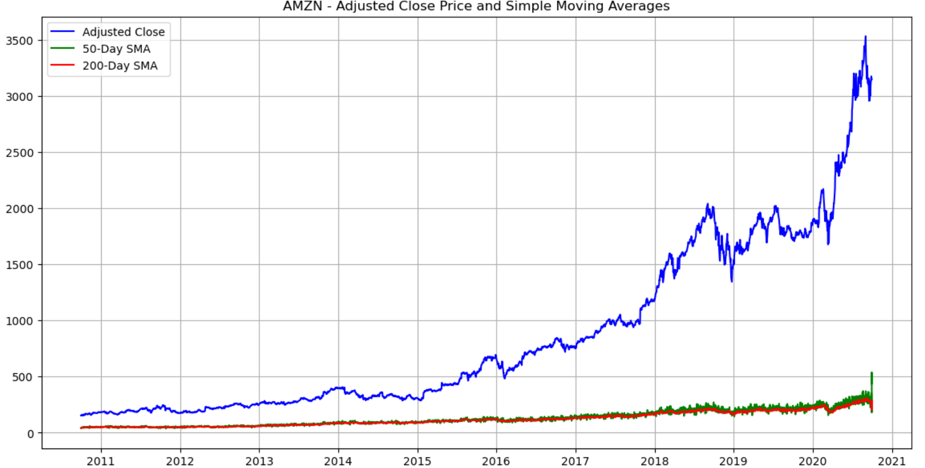
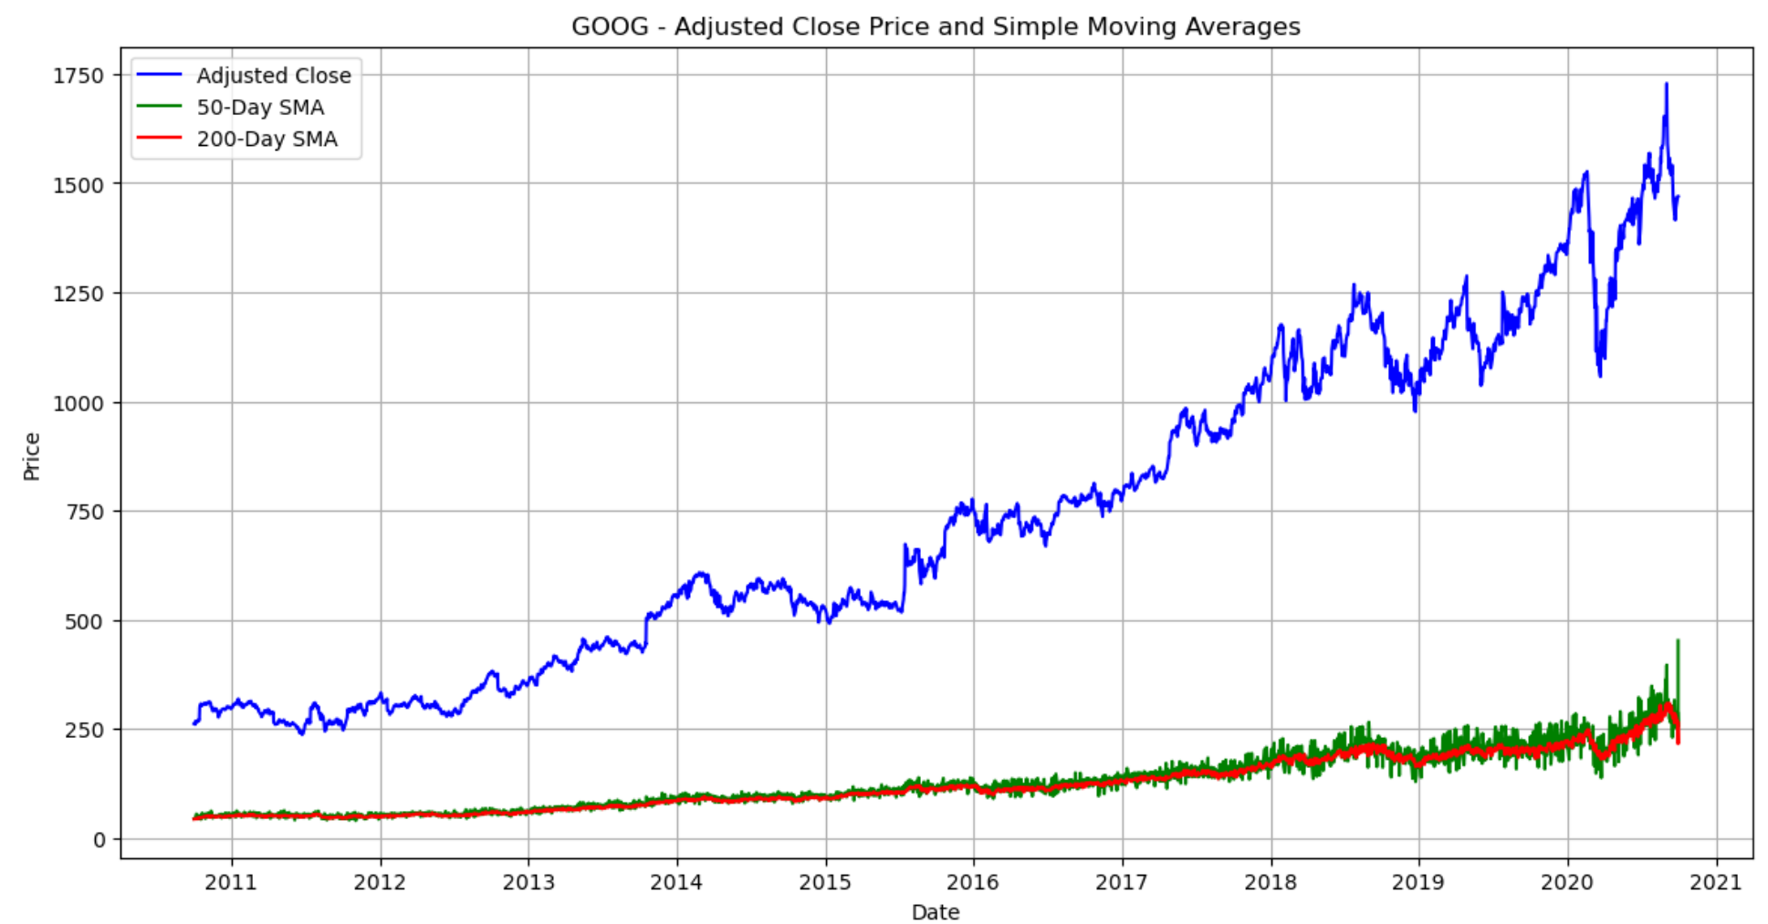
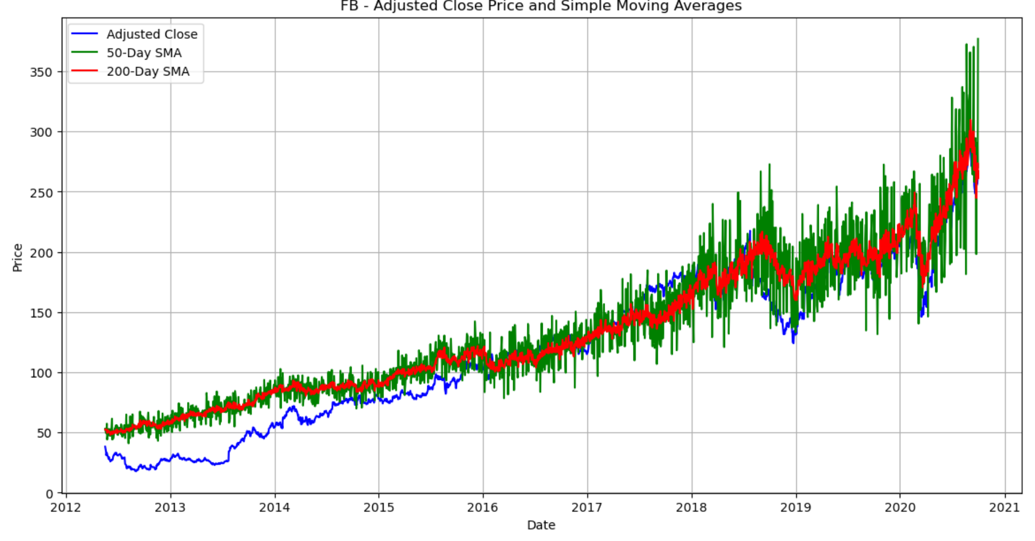
Technology Sector

Slide 12
Technology Sector
1. IBM
2015-2018: Trend direction changed with crossovers.
Post-2018: Stock price declined, indicating potential issues.
2. Microsoft (MSFT)
Upward Trend: Consistent stock price growth.
Post-2019: Alignment with moving averages reflects sustainable performance.
3. Amazon (AMZN)
Upward Trajectory: Strong growth, outperforming moving averages.
4. Alphabet (GOOG)
Upward Trend: Steady growth and dominance over moving averages.
5. Facebook (FB)
Consistent alignment, indicating stable and reliable performance.
Other Stocks:
Underperformance: Most other stocks have underperformed, with adjusted close prices following a downward path compared to SMA50 and SMA200.

Slide 13
Stock Screening Using Data Insights:
RSI (Relative Strength Index): We used RSI to evaluate whether a stock was overbought or oversold, guiding us toward stocks that were either on the rise or potential undervalued buys.
Overbought Stocks: Amazon (AMZN), Facebook (FB), and Alphabet (GOOG) were flagged as overbought, showing strong upward momentum—perfect for Peter's aggressive strategy.
Oversold Stocks: Apple (AAPL), Southwest Airlines (LUV), and Pfizer (PFE) appeared oversold, signaling growth opportunities with moderate risk, aligning with Patrick's conservative goals.

Slide 14
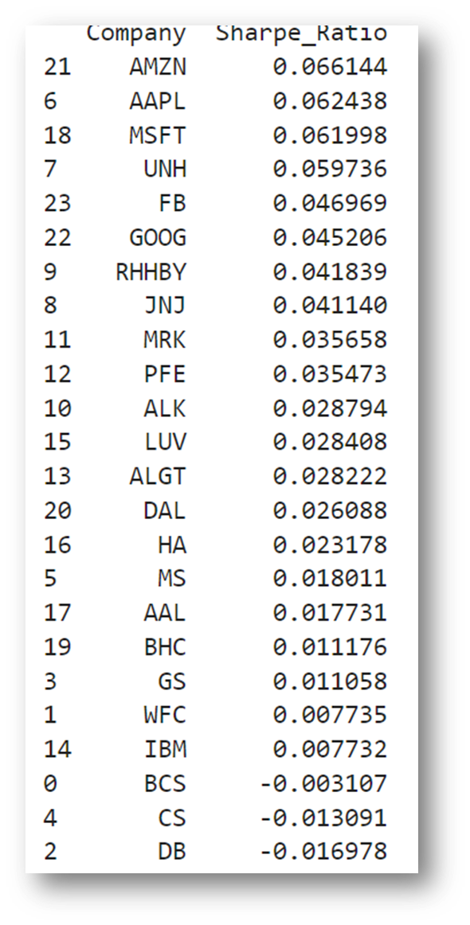
Risk and Return Analysis: Data-Driven Portfolio Optimization
Volatility and Risk:
High Volatility Stocks: Bausch Health Companies (BHC) and American Airlines (AAL) showed high volatility, aligning with Peter’s risk tolerance.
Low Volatility Stocks: Johnson & Johnson (JNJ) and Pfizer (PFE) exhibited lower volatility, making them ideal for Patrick’s portfolio.
Sharpe Ratio Insights:
High Sharpe Ratios: Stocks like Amazon (AMZN), Apple (AAPL), Microsoft (MSFT), and UnitedHealth Group (UNH) delivered strong risk-adjusted returns, balancing the reward-to-risk tradeoff.
These stocks were integrated into both portfolios, but with different weightings based on investor risk tolerance.

Slide 15
Portfolio Recommendations:
Aggressive Portfolio: Mr. Peter Jyengar
Following stocks with the highest historical returns are suggested to maximize gains:
Amazon (AMZN): 36.51% return
Apple Inc. (AAPL): 27.48% return
Microsoft (MSFT): 28.93% return
Facebook (FB): 29.76% return
Projected gains $3.85 million, far exceeding his target of $2 million.

Slide 16
Conservative Portfolio: Mr. Patrick Jyengar
Following stocks with moderate returns and lower volatility are recommended:
UnitedHealth Group (UNH): 25.52% return
Johnson & Johnson (JNJ): 14.51% return
Pfizer (PFE): 11.16% return
Merck & Co. (MRK): 14.62% return
Projected gains $1.07 million, successfully doubling his investment amount with minimal risk.

Slide 17
Conclusion:
By analyzing and refining the financial data, we derived the market insights.
Based on their investment personas, strategies were tailored for both Mr. Patrick and Mr. Peter Jyengar
The portfolios match their risk tolerance and future goals—Mr. Peter's aggressive plan targets high returns, while Mr. Patrick’s conservative approach aims for steady growth over 5 years.

